Slide 1



AI-Driven Technological
Product Recommendation Agent
Revolutionizing User Satisfaction & Decision-Making
Presented by :
Aravind. A - 211211101021
Badresh. B - 211211101025

Slide 2
INTRODUCTION
AI-Powered Tech Product Recommendation Agent
Key Points
Problem Statement
Users face information overload when choosing products and generic recommendations.
Our Idea
An intelligent, conversational chatbot that understands user intent and delivers tailored recommendations in real time.
Value Proposition
Enhanced personalization, improved user satisfaction, and streamlined decision processes.

Slide 3
PROPOSED SOLUTION
Building a chatbot that intelligently suggests products based on user preferences and needs.
Providing a conversational interface for personalized recommendations.
Improving decision-making by understanding user needs and preferences.

Slide 4
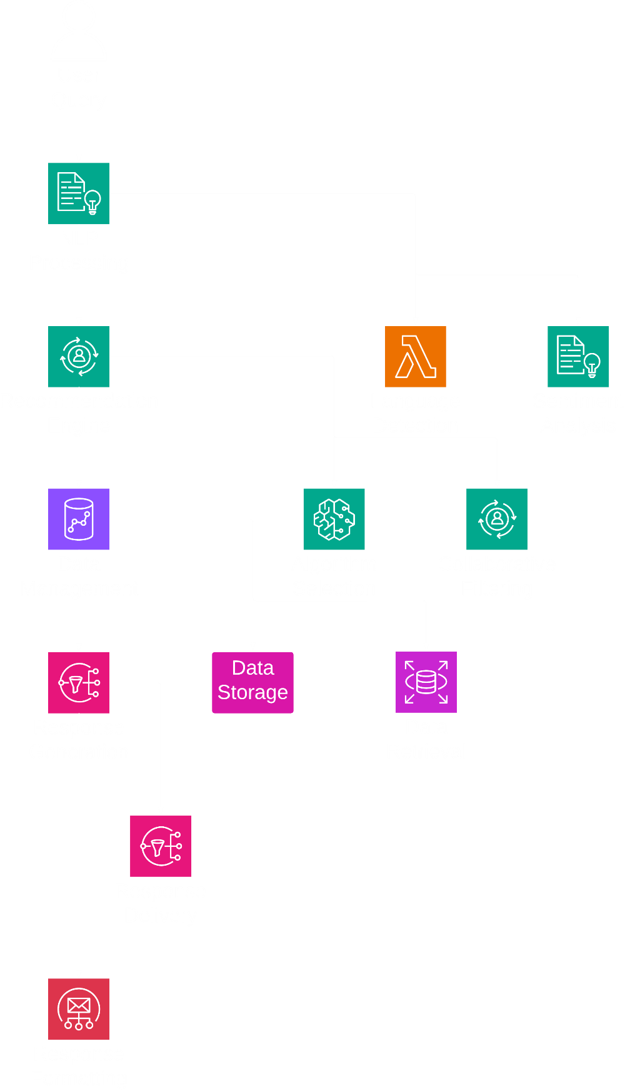





SYSTEM ARCHITECTURE
Key Components (Illustrated as a Simple Diagram):
User Interaction
User asks for recommendation through the chat interface(Text/Voice).
NLP Processing
Interprets user queries and extracts key intents.
Recommendation Engine
Applies content-based and collaborative filtering.
Data Management
Manages product information and user profiles.
Response Generation
Delivers responses via a multi-platform front end.

Slide 5
Module Breakdown & Process Flow
01
02
Recommendation Engine
User Interaction & NLP Processing
Extracting user needs, and identifies preferences (e.g., budget, features, Brand, etc..), and handles ambiguities via follow-up questions.
Using advanced models like OpenAI GPT or Hugging Face for accurate language understanding
Combining content-based and collaborative filtering techniques to generate precise recommendations.
Using Model and machine learning frameworks (e.g., TensorFlow, Scikit-learn) to better recommendations
03
04
Product Information & Data Management
User Interface & Deployment
Efficiently manage product catalogs, ensuring up-to-date and structured data for recommendation accuracy.
Integrate live data feeds via APIs and maintain robust databases.
A seamless, intuitive chat interface accessible on web.
Clean and Simple Modern User Interface for consumer satisfaction
Designed using Html, CSS, JavaScript

Slide 6
FUTURE SCOPE & ENHANCEMENTS
Expanding to multiple domains like healthcare, Finance, Education, Marketing, etc..
Voice-Powered - by supporting voice based queries through integration of Voice Assistants like Google, Alexa, etc..
Cross-Platform & Multi-Channel Integrationchatbots will integrate across WhatsApp, Telegram, Messenger, Web, and Mobile Apps.
Improving the recommendation system by Self-Learning AI with Reinforcement Learning and Advanced AI and Deep Learning for Personalization.
Improving the system to a complete Tech Ecosystem by providing Tech Guides, Tutorials, DIY’s, etc..

Slide 7
CONCLUSION & Q&A
AI-powered recommendations can transform user’s decision-making, and Enhances user experience through smart, Preference based recommendations.
Looking forward to feedback and collaboration!

